Slide 1



Institut Supérieur de l’Aéronautique et de l’Espace Soutenance de Projet de Fin d’Etudes Calibration and Fusion of Stereoscopic and Time-of-Flight Cameras for Zero Gravity Targets Inspection
Auteur: Gabriel Urbain - 3A Supaero - ISAE – France
Encadrants: Daniel Alazard - DEMIA - ISAE – France
José Radzik – DEOS – ISAE - France
Alvar Saenz-Otero – SSL – MIT – USA
Vendredi 24 Octobre 2014

Slide 2
Overview
Introduction
Sensors Features and Acquisition
Time-of-Flight Camera (Optical Range Finder)
Stereoscopic Cameras (VERTIGO)
Thermocam
Calibration Algorithm
ORF calibration
Stereo calibration
System calibration
Fusion Algorithm
Conclusions and Perspectives
Gabriel Urbain – PFE Defense - October 24 2014 2

Slide 3
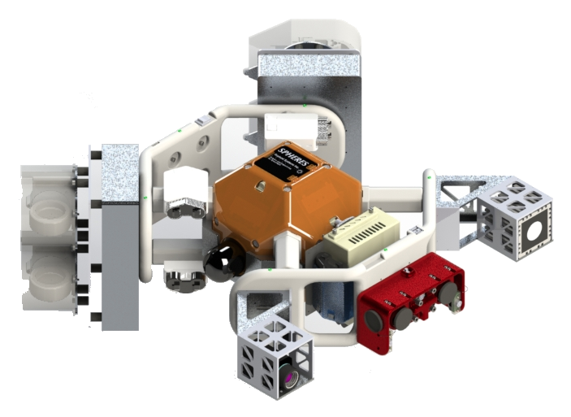
Introduction
INSPECT is an extension of SPHERES intending to test pieces of hardware inside the ISS prior to moving into the vacuum of space
Gabriel Urbain – PFE Defense - October 24 2014 3

Slide 4
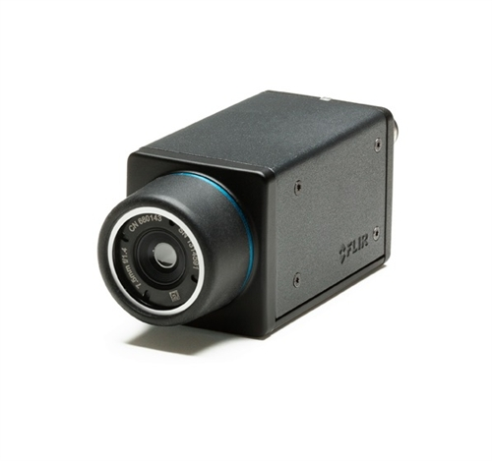
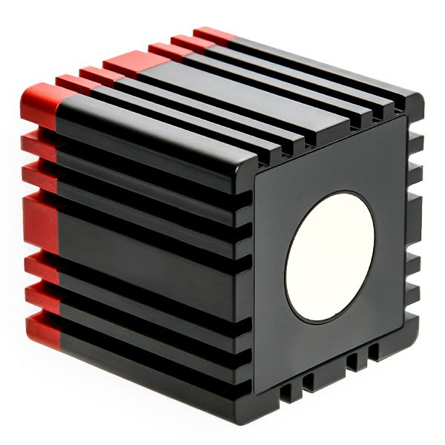
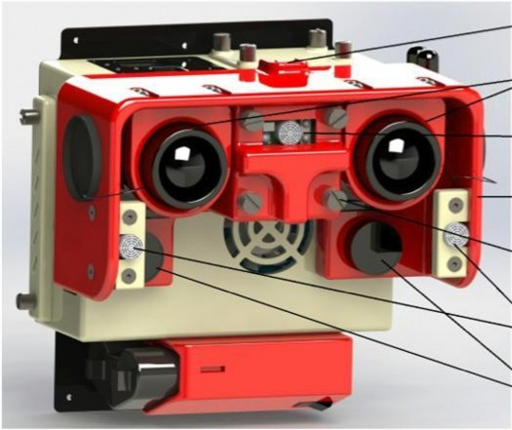
Introductiontion
INSPECT adds two cameras to VERTIGO: a thermocam and an Optical Range Finder to perform Visual Navigation.
Thermocam
Optical Range Finder or
Time-of-Flight Camera
Stereoscopic Cameras of
the VERTIGO Goggles
Gabriel Urbain – PFE Defense - October 24 2014 4

Slide 5
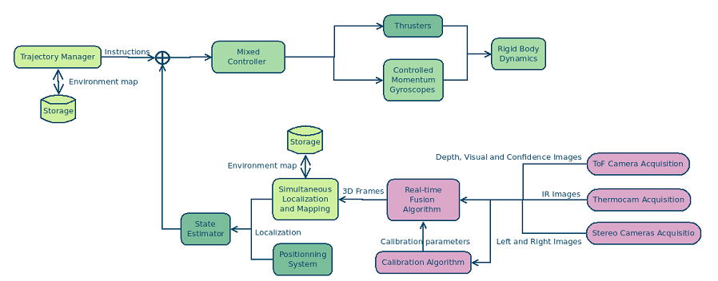
Introduction
Computer Vision enables Simultaneous Localization and Mapping.
Gabriel Urbain – PFE Defense - October 24 2014 5

Slide 6
Overview
Introduction
Sensors Features and Acquisition
Time-of-Flight Camera (Optical Range Finder)
Stereoscopic Cameras (VERTIGO)
Thermocam
Calibration Algorithm
ORF calibration
Stereo calibration
System calibration
Fusion Algorithm
Conclusions and Perspectives
Gabriel Urbain – PFE Defense - October 24 2014 6

Slide 7
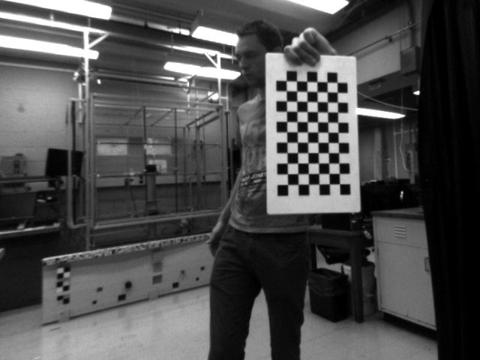
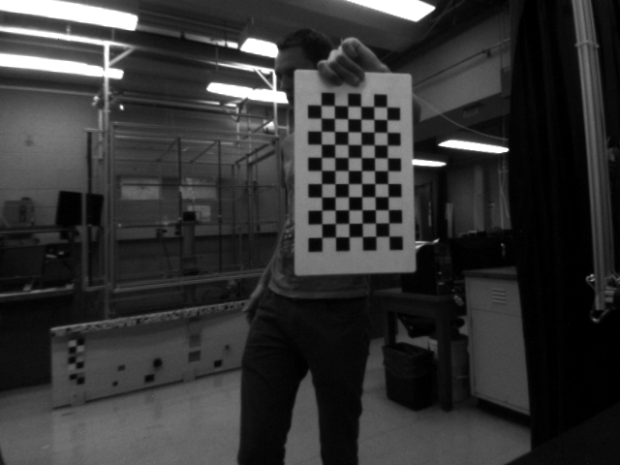
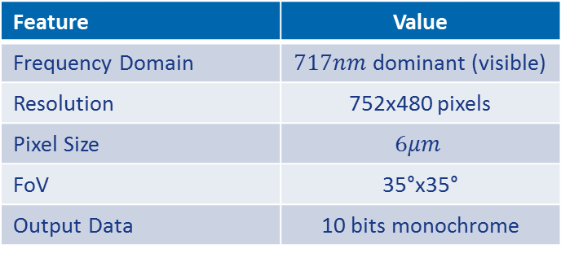
Sensors Features and Acquisition
VERTIGO goggles:
Feature | Value
Frequency Domain | $717nm$ dominant (visible)
Resolution | 752x480 pixels
Pixel Size | $$6μm$$
FoV | 35°x35°
Output Data | 10 bits monochrome
Two images are captured synchronously
Feature Detection and matching
uEye API
Triangulation
Stereo Cameras
Optional: Aggregation and Optimization
Gabriel Urbain – PFE Defense - October 24 2014 7

Slide 8
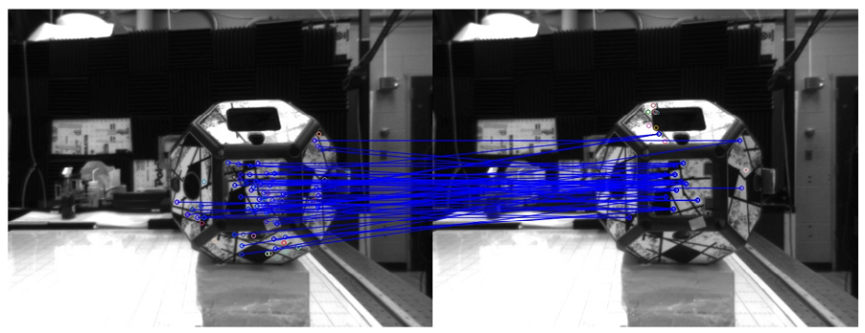
Sensors Features and Acquisition
VERTIGO goggles:
Stereo Cameras
uEye API
Feature Detection and matching
Optional: Aggregation and Optimization
Triangulation
Gabriel Urbain – PFE Defense - October 24 2014 8

Slide 9
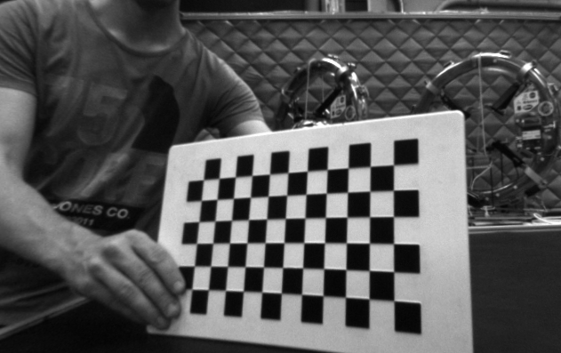
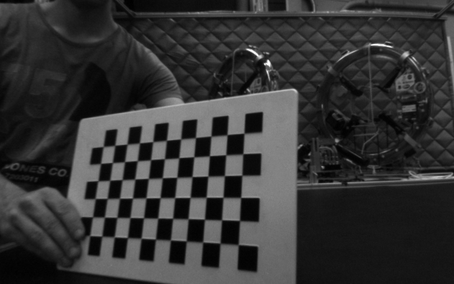
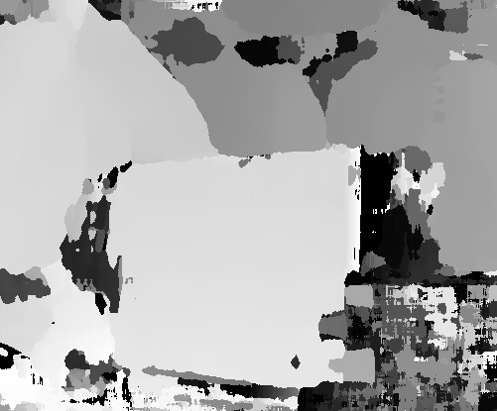
Sensors Features and Acquisition
VERTIGO goggles:
Low-textured objects lead to bad stereo 3D estimations
Stereo Cameras
uEye API
Feature Detection and matching
Optional: Aggregation and Optimization
Triangulation
Gabriel Urbain – PFE Defense - October 24 2014 9

Slide 10
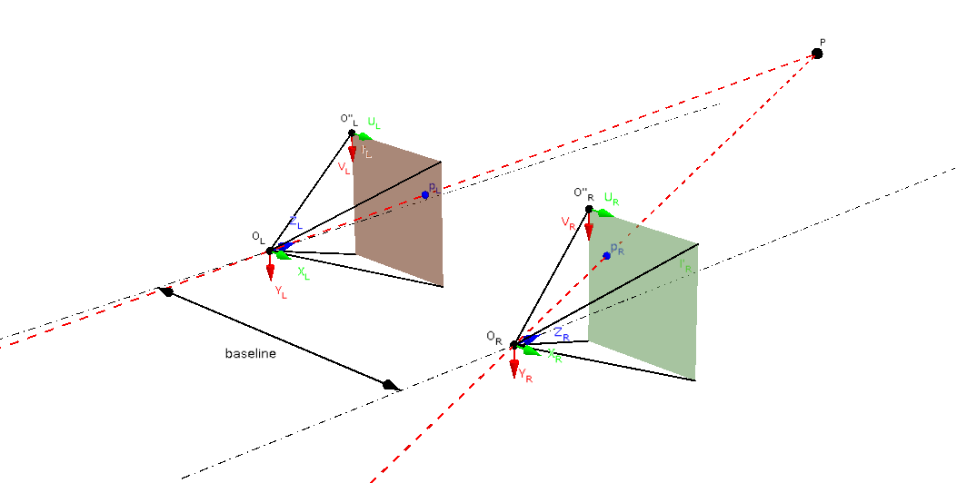
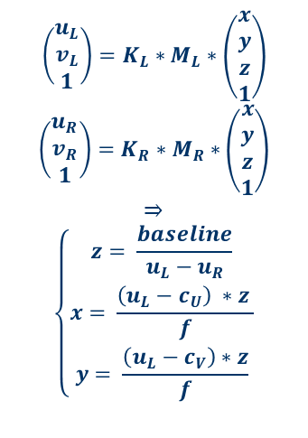
Sensors Features and Acquisition
$$\left(\begin{aligned}u_{L} \\ v_{L} \\ 1\end{aligned}\right)=K_{L}∗M_{L}∗\left(\begin{aligned}x \\ y \\ z \\ 1\end{aligned}\right)$$
$$\left(\begin{aligned}u_{R} \\ v_{R} \\ 1\end{aligned}\right)=K_{R}∗M_{R}∗\left(\begin{aligned}x \\ y \\ z \\ 1\end{aligned}\right)$$
$$⇒$$
$$\left\{\begin{aligned}z= \frac{baseline}{u_{L}−u_{R}} \\ x= \frac{\left(u_{L}−c_{U}\right) ∗z }{f} \\ y= \frac{\left(u_{L}−c_{V}\right)∗z}{f}\end{aligned}\right.$$
VERTIGO goggles:
3D Reconstruction implies knowledge
of intrinsic and extrinsic matrices
Stereo Cameras
uEye API
Feature Detection and matching
Optional: Aggregation and Optimization
Triangulation
Gabriel Urbain – PFE Defense - October 24 2014 10

Slide 11
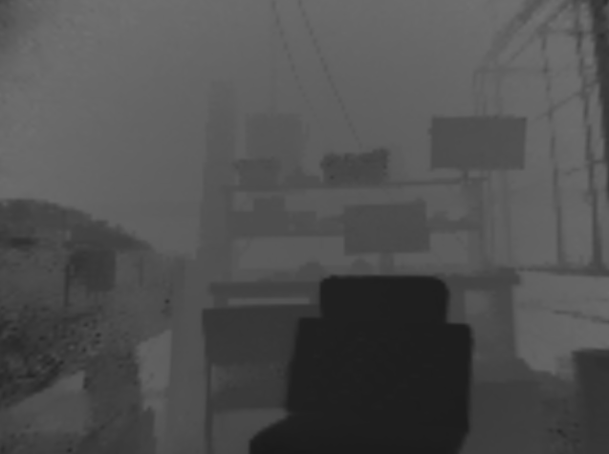
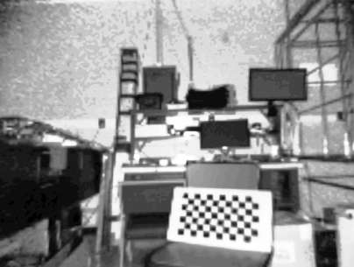
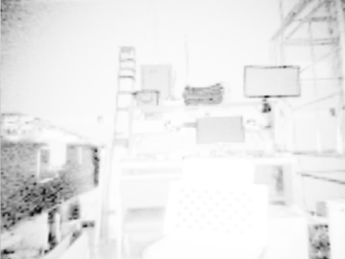
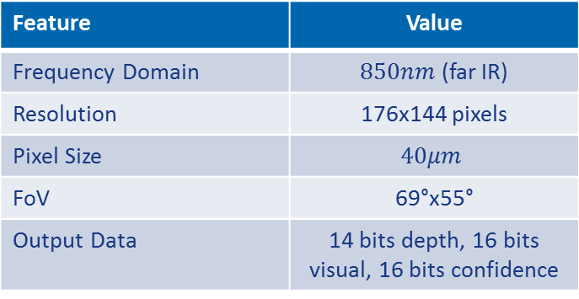
Sensors Features and Acquisition
ORF:
Feature | Value
Frequency Domain | $850nm$ (far IR)
Resolution | 176x144 pixels
Pixel Size | $$40μm$$
FoV | 69°x55°
Output Data | 14 bits depth, 16 bits visual, 16 bits confidence
Three images are captures in the same time: depth, visual, confidence
ORF Camera
3D Reconstruction
MESA-Imaging API
Gabriel Urbain – PFE Defense - October 24 2014 11

Slide 12
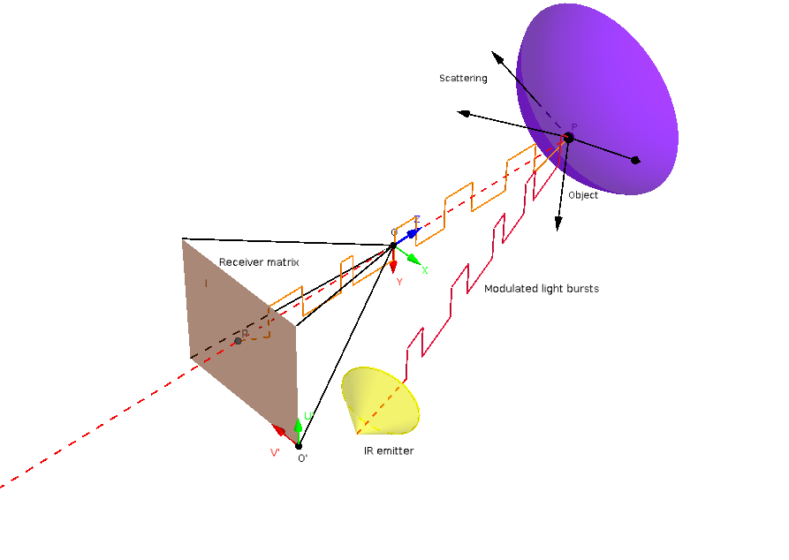
Sensors Features and Acquisition
ORF:
Three images are captures in the same time: depth, visual, confidence
ORF Camera
3D Reconstruction
MESA-Imaging API
Gabriel Urbain – PFE Defense - October 24 2014 12

Slide 13
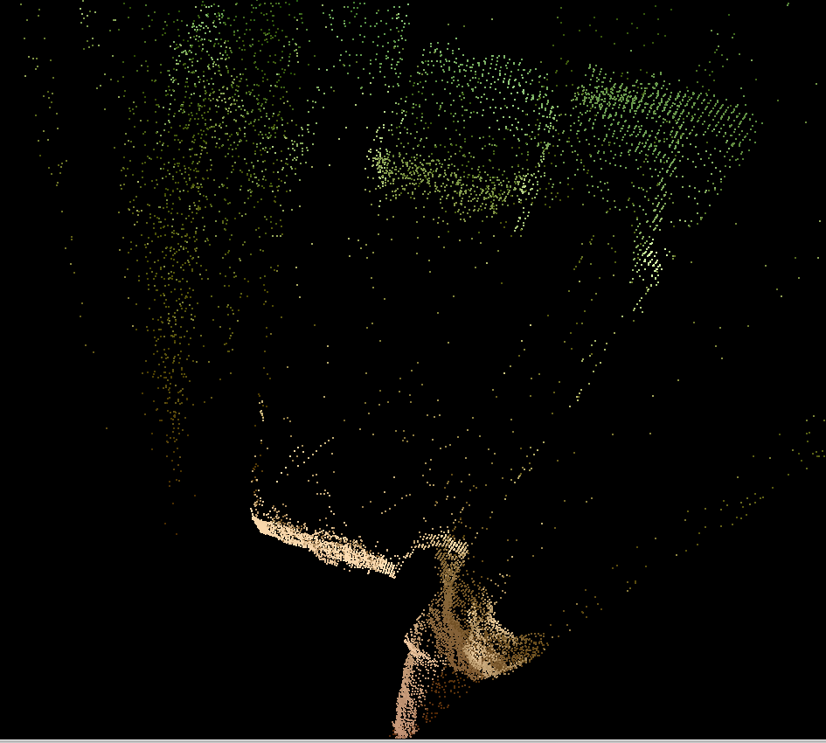
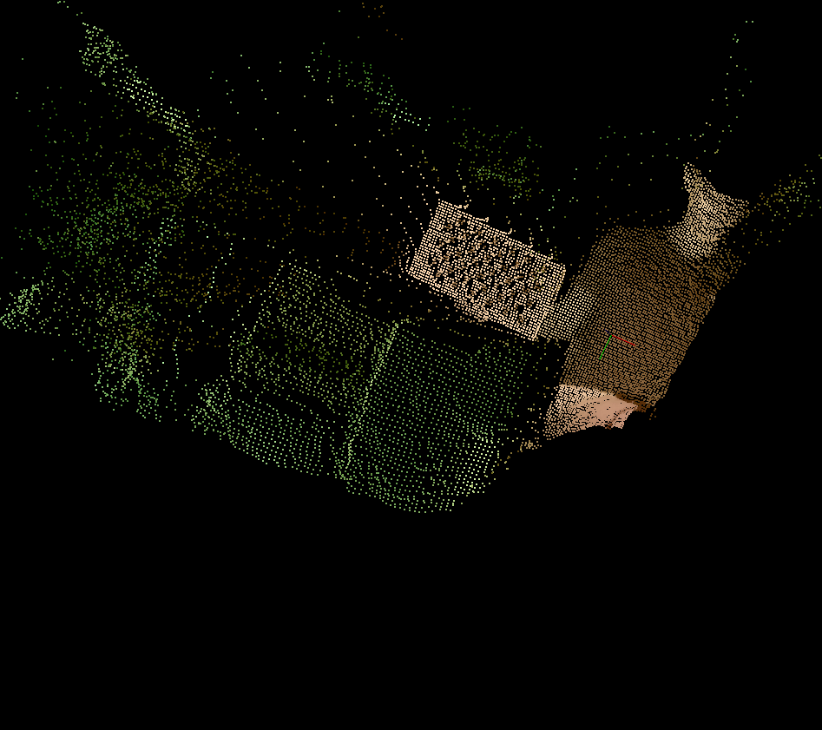
Sensors Features and Acquisition
ORF:
ORF Camera
3D Reconstruction
MESA-Imaging API
Gabriel Urbain – PFE Defense - October 24 2014 13

Slide 14
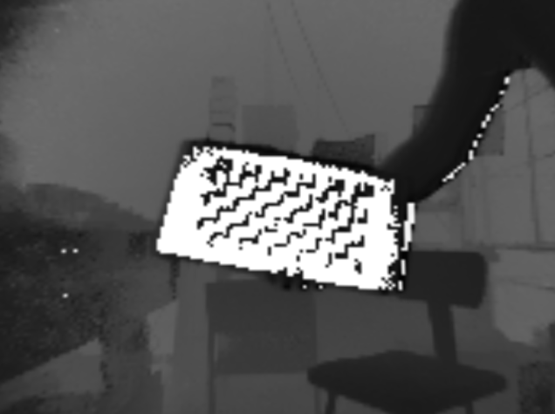
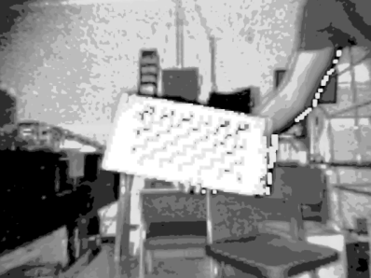
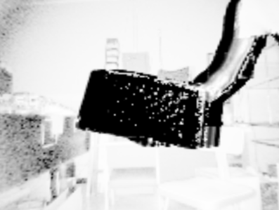
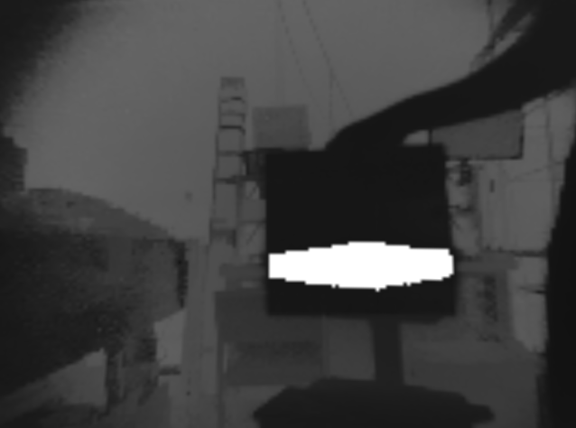
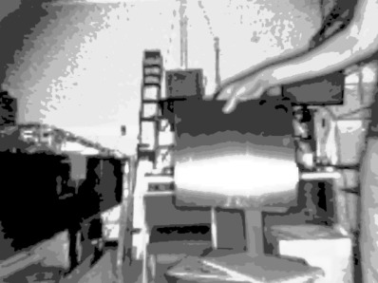
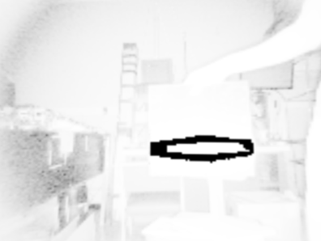
Sensors Features and Acquisition
ORF:
ORF is motion sensitive
ORF is material sensitive
ORF Camera
3D Reconstruction
MESA-Imaging API
Gabriel Urbain – PFE Defense - October 24 2014 14

Slide 15
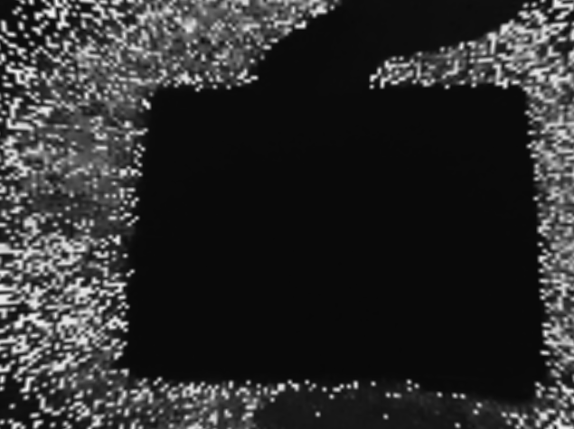
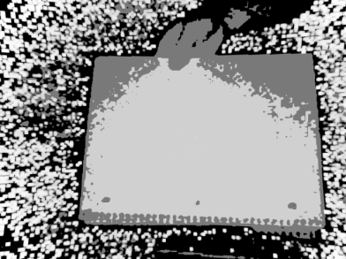



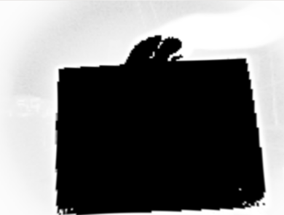
Sensors Features and Acquisition
ORF:
ORF is exposure sensitive
ORF is range sensitive
ORF Camera
3D Reconstruction
MESA-Imaging API
Gabriel Urbain – PFE Defense - October 24 2014 15

Slide 16
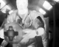
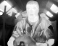
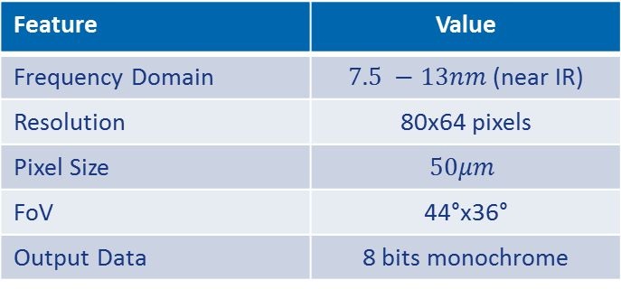
Sensors Features and Acquisition
Thermocam:
Feature | Value
Frequency Domain | $7.5 −13nm$ (near IR)
Resolution | 80x64 pixels
Pixel Size | $$50μm$$
FoV | 44°x36°
Output Data | 8 bits monochrome
The thermocam provides data diversity but with a low resolution
Gabriel Urbain – PFE Defense - October 24 2014 16

Slide 17
Overview
Introduction
Sensors Features and Acquisition
Time-of-Flight Camera (Optical Range Finder)
Stereoscopic Cameras (VERTIGO)
Thermocam
Calibration Algorithm
ORF calibration
Stereo calibration
System calibration
Fusion Algorithm
Conclusions and Perspectives
Gabriel Urbain – PFE Defense - October 24 2014 17

Slide 18
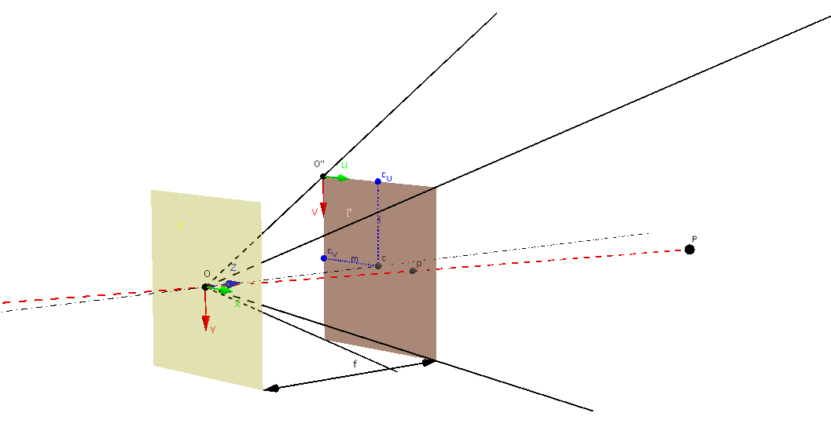
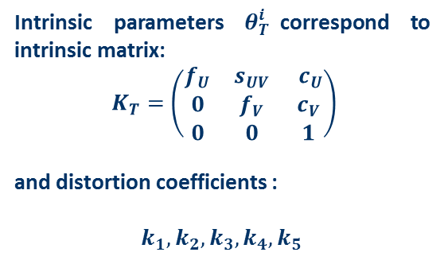
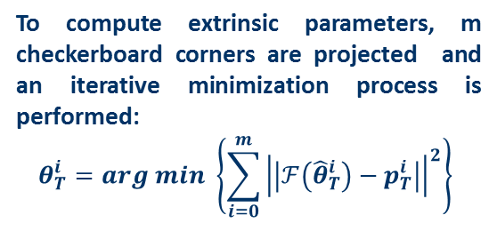
Calibration Algorithm
ORF Calibration (intrinsic):
Intrinsic parameters $θ_{T}^{i}$correspond to intrinsic matrix:
$K_{T}=\left(\begin{matrix}f_{U} & s_{UV} & c_{U} \\ 0 & f_{V} & c_{V} \\ 0 & 0 & 1\end{matrix}\right)$
and distortion coefficients :
$k_{1}, k_{2}, k_{3}, k_{4}, k_{5}$
To compute extrinsic parameters, m checkerboard corners are projected and an iterative minimization process is performed:
$$θ_{T}^{i}=arg min \left\{\sum_{i=0}^{m}{{\left|\left|ℱ\left({\hat{θ}}_{T}^{i}\right)−p_{T}^{i}\right|\right|}^{2}}\right\}$$
Gabriel Urbain – PFE Defense - October 24 2014 18

Slide 19
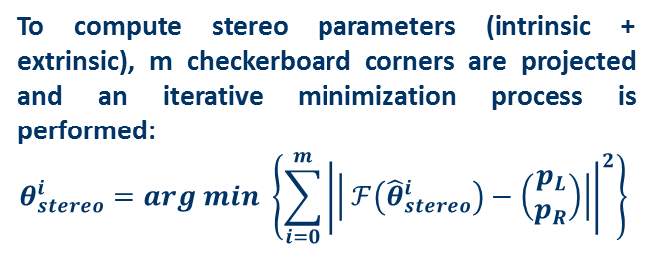
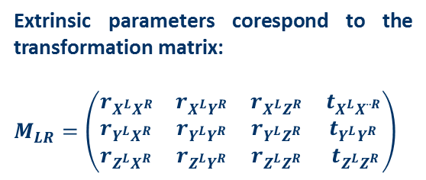
Calibration Algorithm
VERTIGO Calibration (intrinsic + extrinsic):
Extrinsic parameters corespond to the transformation matrix:
$M_{LR}=\left(\begin{matrix}r_{X^{L}X^{R}} & r_{X^{L}Y^{R}} & r_{X^{L}Z^{R}} & t_{X^{L}X¨^{R}} \\ r_{Y^{L}X^{R}} & r_{Y^{L}Y^{R}} & r_{Y^{L}Z^{R}} & t_{Y^{L}Y^{R}} \\ r_{Z^{L}X^{R}} & r_{Z^{L}Y^{R}} & r_{Z^{L}Z^{R}} & t_{Z^{L}Z^{R}}\end{matrix}\right)$
To compute stereo parameters (intrinsic + extrinsic), m checkerboard corners are projected and an iterative minimization process is performed:
$$θ_{stereo}^{i}=arg min \left\{\sum_{i=0}^{m}{{\left|\left| ℱ\left({\hat{θ}}_{stereo}^{i}\right)−\left(\begin{aligned}p_{L} \\ p_{R}\end{aligned}\right)\right|\right|}^{2}}\right\}$$
Gabriel Urbain – PFE Defense - October 24 2014 19

Slide 20
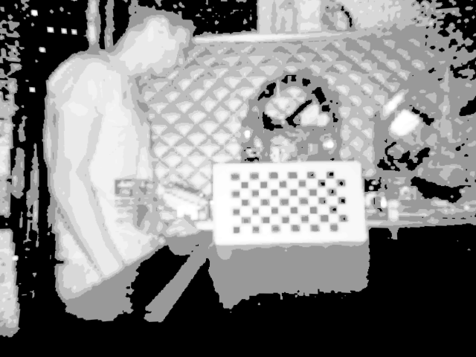
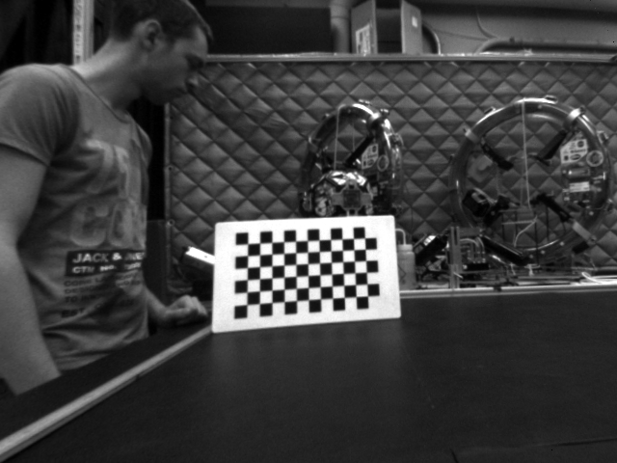
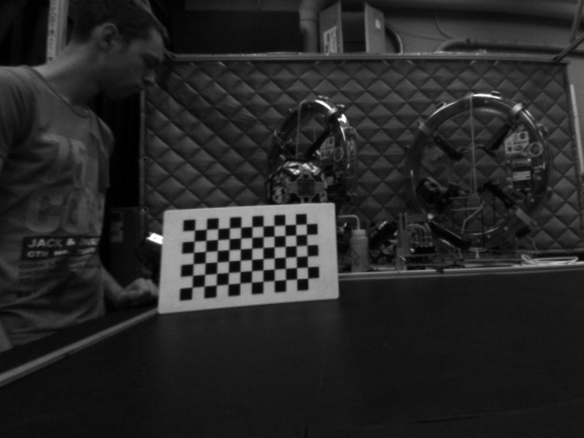
Calibration Algorithm
HALO Calibration (extrinsic):
Three sets of points are deduced:$p_{T}^{i}={\left(\begin{aligned}u \\ v\end{aligned}\right)}_{T}^{i} p_{L}^{i}={\left(\begin{aligned}u \\ v\end{aligned}\right)}_{L}^{i}$ $p_{R}^{i}={\left(\begin{aligned}u \\ v\end{aligned}\right)}_{R}^{i}$
Stereo capture
Checkerboard Corners Detection
Stereo Triangulation
Horn’s minimization algorithm in a RANSAC process
ORF capture
Checkerboard Corners Detection
ORF Pinhole Inversion
Gabriel Urbain – PFE Defense - October 24 2014 20

Slide 21
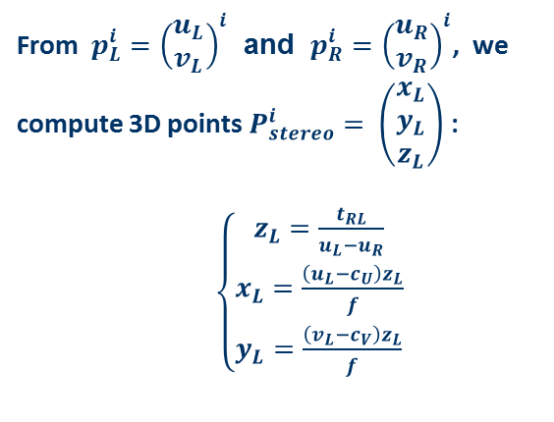
Calibration Algorithm
HALO Calibration (extrinsic):
From $p_{L}^{i}={\left(\begin{aligned}u_{L} \\ v_{L}\end{aligned}\right)}_{}^{i}$ and $p_{R}^{i}={\left(\begin{aligned}u_{R} \\ v_{R}\end{aligned}\right)}_{}^{i}$, we compute 3D points $P_{stereo}^{i}= \left(\begin{aligned}x_{L} \\ y_{L} \\ z_{L}\end{aligned}\right)$ :
$\left\{\begin{aligned}z_{L}=\frac{t_{RL}}{u_{L}−u_{R}} \\ x_{L}=\frac{\left(u_{L}−c_{U}\right)z_{L}}{f} \\ y_{L}=\frac{\left(v_{L}−c_{V}\right)z_{L}}{f}\end{aligned}\right.$
Stereo capture
Checkerboard Corners Detection
Stereo Triangulation
Horn’s minimization algorithm in a RANSAC process
ORF capture
Checkerboard Corners Detection
ORF Pinhole Inversion
Gabriel Urbain – PFE Defense - October 24 2014 21

Slide 22
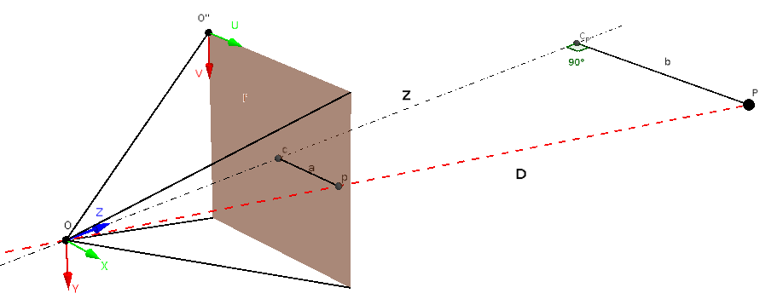
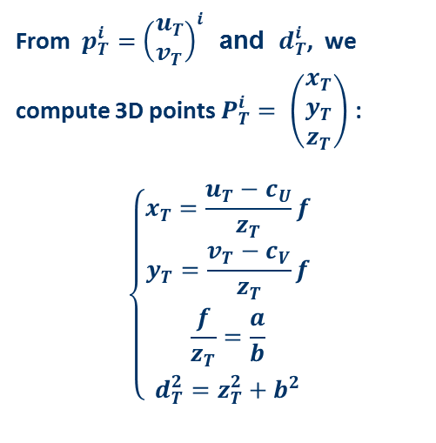
Calibration Algorithm
HALO Calibration (extrinsic):
From $p_{T}^{i}={\left(\begin{aligned}u_{T} \\ v_{T}\end{aligned}\right)}_{}^{i}$ and $d_{T}^{i}$, we compute 3D points $P_{T}^{i}= \left(\begin{aligned}x_{T} \\ y_{T} \\ z_{T}\end{aligned}\right)$ :
$$\left\{\begin{aligned}x_{T}=\frac{u_{T}−c_{U}}{z_{T}}f \\ y_{T}=\frac{v_{T}−c_{V}}{z_{T}}f \\ \frac{f}{z_{T}}=\frac{a}{b} \\ d_{T}^{2}=z_{T}^{2}+b^{2}\end{aligned}\right.$$
Stereo capture
Checkerboard Corners Detection
Stereo Triangulation
Horn’s minimization algorithm in a RANSAC process
ORF capture
Checkerboard Corners Detection
ORF Pinhole Inversion
Gabriel Urbain – PFE Defense - October 24 2014 22

Slide 23
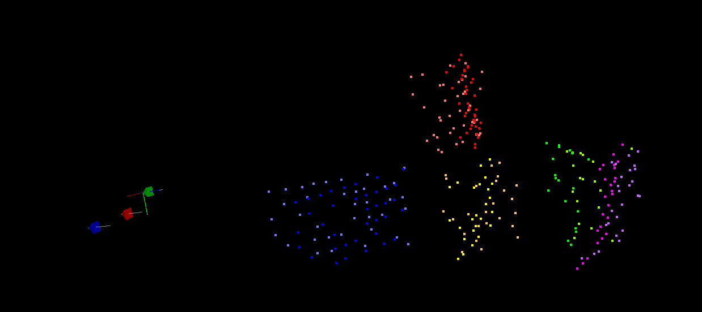
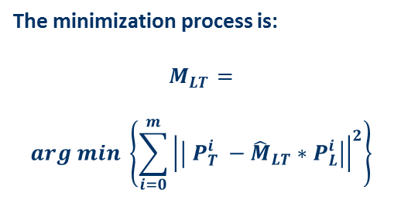
Calibration Algorithm
HALO Calibration (extrinsic):
The minimization process is:
$$M_{LT}=$$
$$arg min \left\{\sum_{i=0}^{m}{{\left|\left| P_{T}^{i} −{\hat{M}}_{LT}∗P_{L}^{i}\right|\right|}^{2}}\right\}$$
Stereo capture
Checkerboard Corners Detection
Stereo Triangulation
Horn’s minimization algorithm in a RANSAC process
ORF capture
Checkerboard Corners Detection
ORF Pinhole Inversion
Gabriel Urbain – PFE Defense - October 24 2014 23

Slide 24
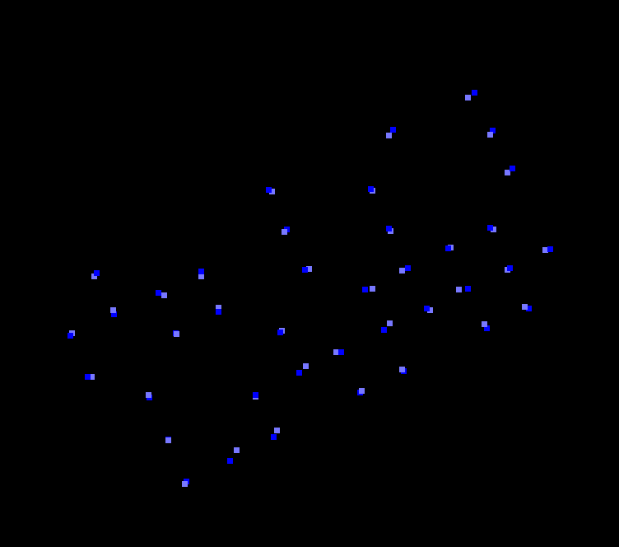
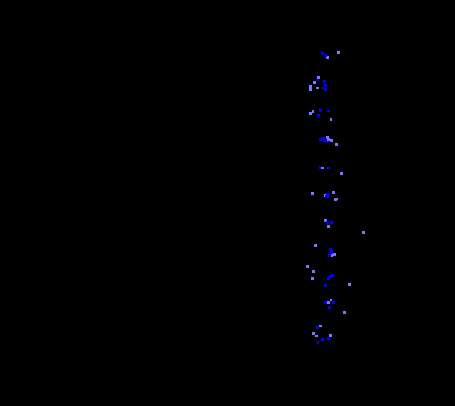
Calibration Algorithm
HALO Calibration (extrinsic):
The minimization process is:
$$M_{LT}=$$
$$arg min \left\{\sum_{i=0}^{m}{{\left|\left| P_{T}^{i} −{\hat{M}}_{LT}∗P_{L}^{i}\right|\right|}^{2}}\right\}$$
Stereo capture
Checkerboard Corners Detection
Stereo Triangulation
Horn’s minimization algorithm in a RANSAC process
ORF capture
Checkerboard Corners Detection
ORF Pinhole Inversion
Gabriel Urbain – PFE Defense - October 24 2014 24

Slide 25
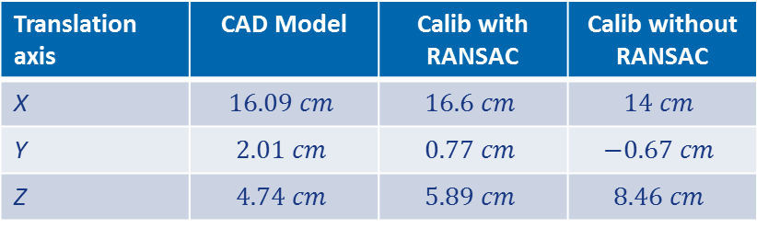
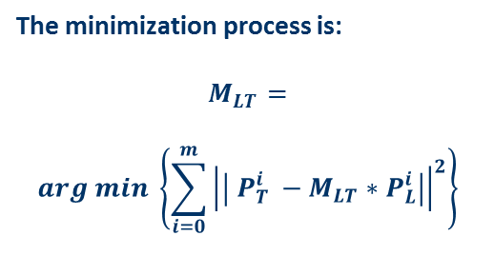
Calibration Algorithm
HALO Calibration (extrinsic):
The minimization process is:
$$M_{LT}=$$
$$arg min \left\{\sum_{i=0}^{m}{{\left|\left| P_{T}^{i} −M_{LT}∗P_{L}^{i}\right|\right|}^{2}}\right\}$$
Translation axis | CAD Model | Calib with RANSAC | Calib without RANSAC
X | $$16.09 cm$$ | $$16.6 cm$$ | $$14 cm$$
Y | $$2.01 cm$$ | $$0.77 cm$$ | $$−0.67 cm$$
Z | $$4.74 cm$$ | $$5.89 cm$$ | $$8.46 cm$$
Stereo capture
Checkerboard Corners Detection
Stereo Triangulation
Horn’s minimization algorithm in a RANSAC process
ORF capture
Checkerboard Corners Detection
ORF Pinhole Inversion
Gabriel Urbain – PFE Defense - October 24 2014 25

Slide 26
Overview
Introduction
Sensors Features and Acquisition
Time-of-Flight Camera (Optical Range Finder)
Stereoscopic Cameras (VERTIGO)
Thermocam
Calibration Algorithm
ORF calibration
Stereo calibration
System calibration
Fusion Algorithm
Conclusions and Perspectives
Gabriel Urbain – PFE Defense - October 24 2014 26

Slide 27
Fusion Algorithm
Goals of multi-sensor data fusion:
For this algorithm:
Increase accuracy
Increase certainty
Increase completeness
Increase representation
Gabriel Urbain – PFE Defense - October 24 2014 27

Slide 28
Fusion Algorithm
Goals of multi-sensor data fusion:
For a future algorithm:
Increase accuracy
Increase certainty
Increase completeness
Increase representation
Gabriel Urbain – PFE Defense - October 24 2014 28

Slide 29



Fusion Algorithm
ORF Depth
Stereo Left
ORF Confidence
ORF Visual
Stereo Right
Acquisition
Determination of Points Framed by all Sensors
ORF Noise Model
Noise Interval Discretization
Stereo projection
Probability maximization
Gabriel Urbain – PFE Defense - October 24 2014 29

Slide 30


Fusion Algorithm
$$z_{i} ∈\left[min \left( \frac{t_{TR }\tan\left(ρ\right)\tan\left(τ\right)}{\tan\left(ρ\right)+\tan\left(τ\right) }, range_{min}\right);range_{max}\right]$$
$$x_{i} ∈\left[\frac{−z_{i} − t_{TR }\tan\left(ρ\right)}{\tan\left(ρ\right)} ;\frac{z_{i}}{\tan{(τ)}} \right]$$
$$y_{i}∈ \left[min \left( \frac{−z_{i}}{\tan{(ρ)}},\frac{−z_{i}}{\tan{(τ)}}\right);min \left( \frac{−z_{i}}{\tan{(ρ)}},\frac{−z_{i}}{\tan{(τ)}}\right)\right]$$
Acquisition
Determination of Points Framed by all Sensors
ORF Noise Model
Noise Interval Discretization
Stereo projection
Probability maximization
Gabriel Urbain – PFE Defense - October 24 2014 30

Slide 31


Fusion Algorithm
For each 3D point constructed by the ORF, ORF noise can be reduce to a Normal with variance $σ_{w}$ including:
Thermal noise with variance $σ_{t}$
Scattering noise with variance $σ_{s}$
Acquisition
Determination of Points Framed by all Sensors
ORF Noise Model
Noise Interval Discretization
Stereo projection
Probability maximization
Gabriel Urbain – PFE Defense - October 24 2014 31

Slide 32


Fusion Algorithm
The interval $\left[d_{i}−3σ_{w};d_{i}+3σ_{w}\right]$ can be split in m steps of size $ε_{d}=\frac{d^{2}}{b f }ε_{p}$
Acquisition
Determination of Points Framed by all Sensors
ORF Noise Model
Noise Interval Discretization
Stereo projection
Probability maximization
Gabriel Urbain – PFE Defense - October 24 2014 32

Slide 33

Fusion Algorithm
Acquisition
Determination of Points Framed by all Sensors
ORF Noise Model
Noise Interval Discretization
Stereo projection
Probability maximization
Gabriel Urbain – PFE Defense - October 24 2014 33

Slide 34


Fusion Algorithm
Each $P^{i,j}$is projected in left and right images and a degree of likeliness is computed around each points:
$$c_{i,j}=$$
$min\left\{\sum_{k}{\sum_{l}{|I_{L}\left(u_{i,j}+k, v_{i,j}+l\right)− I_{L}\left(u_{i,j}+k, v_{i,j}+l\right)}}\right|, thresh\}$
Acquisition
Determination of Points Framed by all Sensors
ORF Noise Model
Noise Interval Discretization
Stereo projection
Probability maximization
Gabriel Urbain – PFE Defense - October 24 2014 34

Slide 35


Fusion Algorithm
Acquisition
Determination of Points Framed by all Sensors
ORF Noise Model
Noise Interval Discretization
Stereo projection
Probability maximization
Gabriel Urbain – PFE Defense - October 24 2014 35

Slide 36

Fusion Algorithm
Probability is computed as:
$$P\left[d^{i}=d^{i,j}\right]=P\left[d^{i}=d^{i,j} | I_{T}\right]∗P\left[d^{i}=d^{i,j} | I_{L}I_{R}\right]$$
Where:
$P\left[d^{i}=d^{i,j} | I_{T}\right]= \frac{1}{σ_{w}^{i}\sqrt{2π}}e^{−\frac{{\left(d^{i,j}−d^{i}\right)}^{2}}{2 {σ_{w}^{i}}^{2}}}$
$$P\left[d^{i}=d^{i,j} | I_{L}I_{R}\right]= e^{\frac{−c_{i,j}}{σ_{n}^{i}}}$$
And finally,
$${\hat{d}}^{i}=max_{j} \{P[d^{i}=d^{i,j}]\}$$
Acquisition
Determination of Points Framed by all Sensors
ORF Noise Model
Noise Interval Discretization
Stereo projection
Probability maximization
Gabriel Urbain – PFE Defense - October 24 2014 36

Slide 37


Fusion Algorithm
In the first results with INSPECT, fusion (right) does not improve accuracy of the ORF cloud (left)
Gabriel Urbain – PFE Defense - October 24 2014 37

Slide 38

Fusion Algorithm
In the first results with INSPECT, fusion (right) does not improve accuracy of the ORF cloud (left)
Gabriel Urbain – PFE Defense - October 24 2014 38

Slide 39


Fusion Algorithm
Errors seem to come essentially from stereo calibration matrices accuracy and non-linearity of the process
Gabriel Urbain – PFE Defense - October 24 2014 39

Slide 40
Overview
Introduction
Sensors Features and Acquisition
Time-of-Flight Camera (Optical Range Finder)
Stereoscopic Cameras (VERTIGO)
Thermocam
Calibration Algorithm
ORF calibration
Stereo calibration
System calibration
Fusion Algorithm
Conclusions and Perspectives
Gabriel Urbain – PFE Defense - October 24 2014 40

Slide 41
Conclusions and Future Perspectives
Acquisition seems to give acceptable results on the ground and during RGA flights.
The calibration algorithm gives good results but could be improved by:
Adding the thermocam by using a cold/hot checkerboard pattern
Using better stereo calibration parameters during system calibration
The fusion algorithm does not increase accuracy for the moment (on the ground and during RGA flights) and will not for sure increase completeness and certainty:
A way to improve it would be a better ORF noise computation or stereo likeliness determination
The thermocam should be added to create a second point cloud
Other algorithms have been found that are more adapted to SLAM, avoid the stereo re-projection and consider full objects instead of separated points
Gabriel Urbain – PFE Defense - October 24 2014 41

